Slide 1

WORKNET INTERNATIONAL
International Nurse Recruitment for German Healthcare Providers
Hamburg, Germany

Slide 2

Healthcare Workforce Challenges
Growing demand for nursing professionals
Integration challenges
Need for sustainable staffing solutions
Long recruitment cycles

Slide 3

About Worknet International
Based in Hamburg, Germany
Worknet International supports hospitals, clinics, nursing homes, rehabilitation centres, and healthcare providers through structured international nurse recruitment.

Slide 4
Our Recruitment Journey
Screening
Language Training
Interview
Preparation
Employer
Matching
Visa
Support
Arrival & Integration
Every candidate follows a structured pathway designed to ensure successful recruitment, relocation, and long-term integration into the German healthcare system.

Slide 5

Language Training Excellence
Training delivered by C1-certified teachers
Continuous progress monitoring
Structured learning plans
Interview Preparation
Health-care focused communication skills

Slide 6

Quality Assurance
Qualification Review
Motivation Evaluation
Documentation Verification
Language Assessment
Communication Skills Evaluation
Long-Term Commitment Assessment

Slide 7

Support Beyond Recruitment
✅ Visa Support
✅ Documentation Assistance
✅ Interview Preparation
✅ Recognition Assistance
✅ Arrival Coordination
✅ Ongoing Candidate Assistance
✅ Family Relocation Guidance (if applicable)

Slide 8

Why Healthcare Providers Choose Us
Traditional Recruitment | Worknet International
Candidate Sourcing | End-to-end support
Limited Preparation | Structured Preparation
Transactional Process | Long-term partnership
Basic screening | Comprehensive evaluation

Slide 9
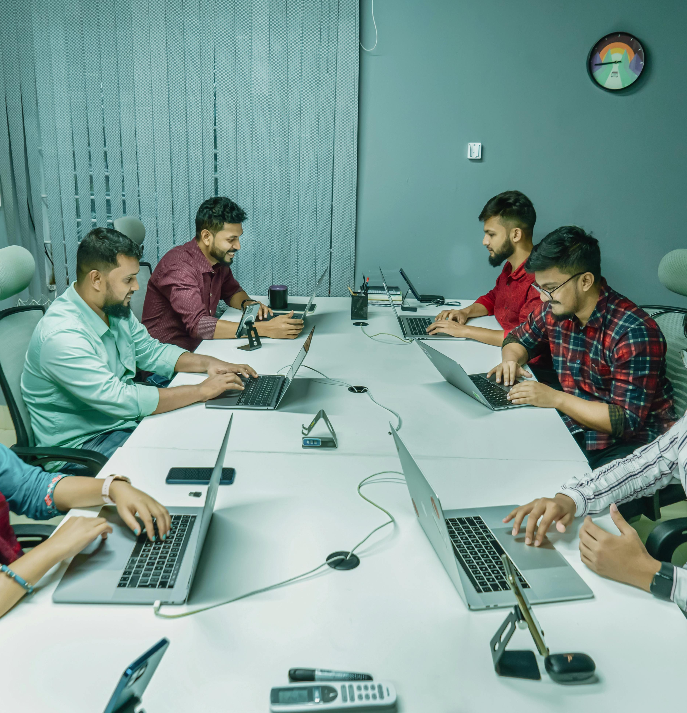

Why Worknet International
Germany-based
C1-certified language trainers
Transparent communication
Long-term integration focus
Quality-focused recruitment
Dedicated employer support

Slide 10
Let's Build the Future of Healthcare Together
Worknet International
Hamburg, Germany
www.worknet-international.de || info@worknet-international.de

